Slide 1
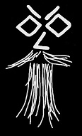
Describing Presentation
Context Presentation
[+] Title Should Be 'Introduction to Pester‘ 89ms
[+] Should have many Demos 8ms
Context Speaker
[+] Name should be Rob Sewell 51ms
[+] Twitter Should be @sqldbawithbeard 19ms
[+] Website Should be sqldbawithAbeard.com 12ms
Context Audience
[+] Audience should be awesome 60ms
[!] They should not fall asleep 7ms

Slide 2

speaker questionnaire
Name : Rob
Occupation : DBA, Automator, Do-er, Trainer, DevOpser!
Available for hire ☺ - RobSewell.info
Interests : PowerShell, Automation And SQL (PaaS geddit?)
Interesting Fact : Beard. (Still) Plays Cricket, Flies Drone
Speaker : PsConfEU, PsConfAsia, PSSaturdays, PSMondays, User Groups PowerShell and SQL
Community : PowerShell VG, PowerShell Conference EU Organiser, PSDayUK Organiser, SQL South West , SQL Sat Exeter , dbareports, dbatools, SQLDiagAPI, MVP

Slide 3
speaker questionnaire
Name : Rob
Occupation : DBA, Automator, Do-er, Trainer, DevOpser!
Available for hire ☺ - RobSewell.info
Interests : PowerShell, Automation And SQL (PaaS geddit?)
Interesting Fact : Beard. (Still) Plays Cricket, Flies Drone
Speaker : PsConfEU, PsConfAsia, PSSaturdays, PSMondays, User Groups PowerShell and SQL
Community : PowerShell VG, PowerShell Conference EU Organiser, PSDayUK Organiser, SQL South West , SQL Sat Exeter , dbareports, dbatools, SQLDiagAPI, MVP

Slide 4
What is Pester?
Pester provides a framework for running unit tests to execute and validate PowerShell commands from within PowerShell
https://github.com/pester/Pester

Slide 5
Why Test?
Good tests can…
Verify the code is working correctly
Prevent future regressions
Document the code’s behaviour
Provide design guidance
Support refactoring
https://www.devmynd.com/blog/five-factor-testing/
Notes:
Does it do what I want
If I change it does it do what I want
What is it supposed to do
This is how it is designed
Does it still do what we want when we make big changes

Slide 6
How Do I Get Pester?
If you have PowerShell V5 or above you already have it.
You should update (well install really) it using
Install-Module Pester -SkipPublisherCheck –Force
You should also update regularly
Update-Module Pester
Use –Scope Current User if not running as Admin Process

Slide 7
What does Pester Look Like?

Slide 8
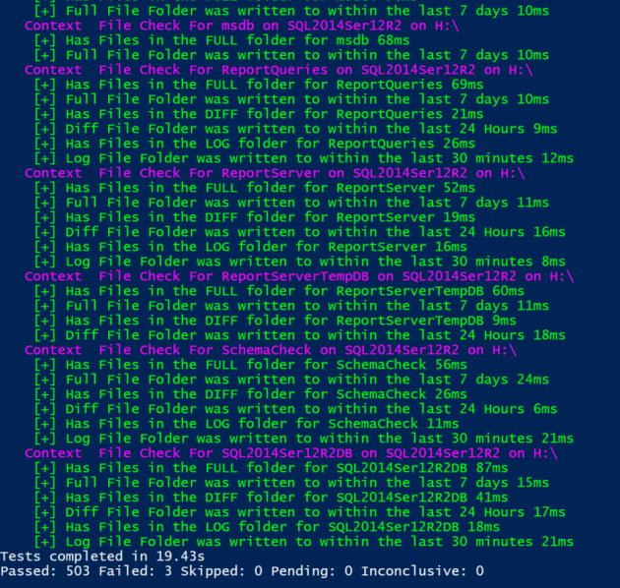
Environmental Validation
As Pester is just PowerShell you can use it to validate the results of any PowerShell command
This is BRILLIANT for validating your environment

Slide 9

How Do I Start?
Hey Beardy !
MUST BE TIME FOR A DEMO

Slide 10
Two things we didnt show
Test Drive
A drive created in $ENV:Temp that is accessible via $TestDrive and exists within the scope of a Describe block
In ModuleScope
This tells Pester to inject the mock into the module's scope, which causes any calls to those commands from inside the module to execute the mock instead.

Slide 11
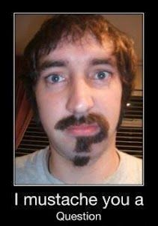
Questions?
?
?
?
?
?
?
?
?
?
?
?
?
?
?
?
?
Rob Sewell @sqldbawithbeard https://sqldbawithAbeard.com

Slide 12
Further Information
Adam Bertram – The Pester Book
https://leanpub.com/pesterbook
Test-Driven Development with Pester (June Blender)
https://www.youtube.com/watch?v=gssAtCeMOoo
https://sqldbawithabeard.com/tag/tdd/
https://www.pluralsight.com/courses/powershell-testing-pester
Rob Sewell @sqldbawithbeard https://sqldbawithAbeard.com

